Slide 1
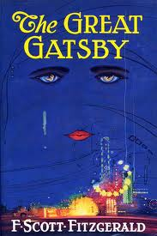
Symbolic Colors in The Great Gatsby
List whatever comes to mind when you see each following colors

Slide 2
Red

Slide 3
Green

Slide 4
Yellow

Slide 5
Black

Slide 6
Gold

Slide 7
White

Slide 8
Now let’s look at The Great Gatsby

Slide 9
When considering symbolism, think about the following
Reoccurring symbols within different contexts
Which characters are represented through the use of symbolism
How symbolism is used to create mood, attitude, or implication
and lastly . . .
How specific symbols effects the entire outlook of the novel.

Slide 10
What is the common interpretation of the color yellow?
Cheerful sunny yellow is an attention getter. While it is considered an optimistic color, people lose their tempers more often in yellow rooms, and babies will cry more. It is the most difficult color for the eye to take in, so it can be overpowering if overused. Yellow enhances concentration, hence its use for legal pads. It also speeds metabolism.

Slide 11
YELLOW
What do you think of when you see yellow?
The sun
Fake gold
Morning
Happy

Slide 12
“He had changed since his New Haven years. Now he was a sturdy, straw haired man of thirty with a rather hard mouth and a supercilious manner” (9).
Here, Tom’s hair has undergone change—it is now a straw color.
What do we know about Tom?
Tom is selfish, dishonest, corrupt, and conceited
He cheats on his wife.
He only cares about himself.
He acts as an “alpha-male.”

Slide 13
“The lamp-light, bright on his boots and dull on the autumn-leaf yellow of her hair, glinted along the paper as she turned a page with a flutter of slender muscles in her arms” (21).
Here, Jordan’s hair is described as autumn-leaf yellow.
What do we know about Jordan?
Jordan is manipulative, dishonest, and peculiar
She moved her ball in the semi-final round.
She lies about closing the roof on the convertible.

Slide 14
“She held my hand impersonally, as a promise that she’d take care of me in a minute, and gave ear to two girls in twin yellow dresses who stopped at the foot of the steps” (47).
Here, Jordan speaks into the ear of one of the girls in the yellow dress’.
How does yellow contribute to Jordan’s character further?
We know she knows the girl—for she speaks personally to her—yet we don’t know what she says nor do we know much about this girl.
We are inclined to question the history between Jordan and this girl—they are compared through “yellow.”

Slide 15
“His Rolls-Royce became an omnibus, bearing parties to and from the city, between nine in the morning and long past midnight, while his station wagon scampered like a brisk yellow bug . . .” (43).
Here is the first time we see Gatsby associated with the color yellow.
What do we know about Gatsby?
Gatsby is generous and nice, yet he is also secretive and corrupt.
No one really knows what he does.
He lies about his past—wealth and education (for example).

Slide 16
“Yet high over the city our line of yellow windows must have contributed their share of human secrecy to the casual watcher in the darkening streets” (39).
Here, Nick implies that the yellow windows veil the secrecy within the buildings. Yellow symbolically classifies everyone in the building, including Nick.
Tom and Myrtle are both cheating.
Mr. McKee is controlling over his wife.
Nick is a hypocrite and liar.
He is not engaged.

Slide 17
Based on what we know about the characters and what we have learned about the color yellow in The Great Gatsby, what can we conclude?
Yellow symbolizes corruption and things that go bad. Tom, Myrtle, Gatsby, the McKee’s, and Jordan are all dishonest and corrupt.
Yellow symbolizes all of these characters.
All of these characters are powerful in their own ways, much like yellow.

Slide 18
What about Daisy?
In order to see yellow in Daisy, we are obligated to dig a little deeper to find it.
“Insisted Daisy, surprising me by opening up again in a flower-like way” (23).
Here, Daisy is described as opening like a flower. also . . .
Her name is Daisy!

Slide 19
So what now?
Well,
“Our white girlhood was passed together there. Our beautiful white——”(22).
Here, Jordan claims that their “white girlhood” has passed.
So if Daisy was a white flower . . .
She is now—seeing how she has grown—yellow on the inside, much like white daisies are.

Slide 20
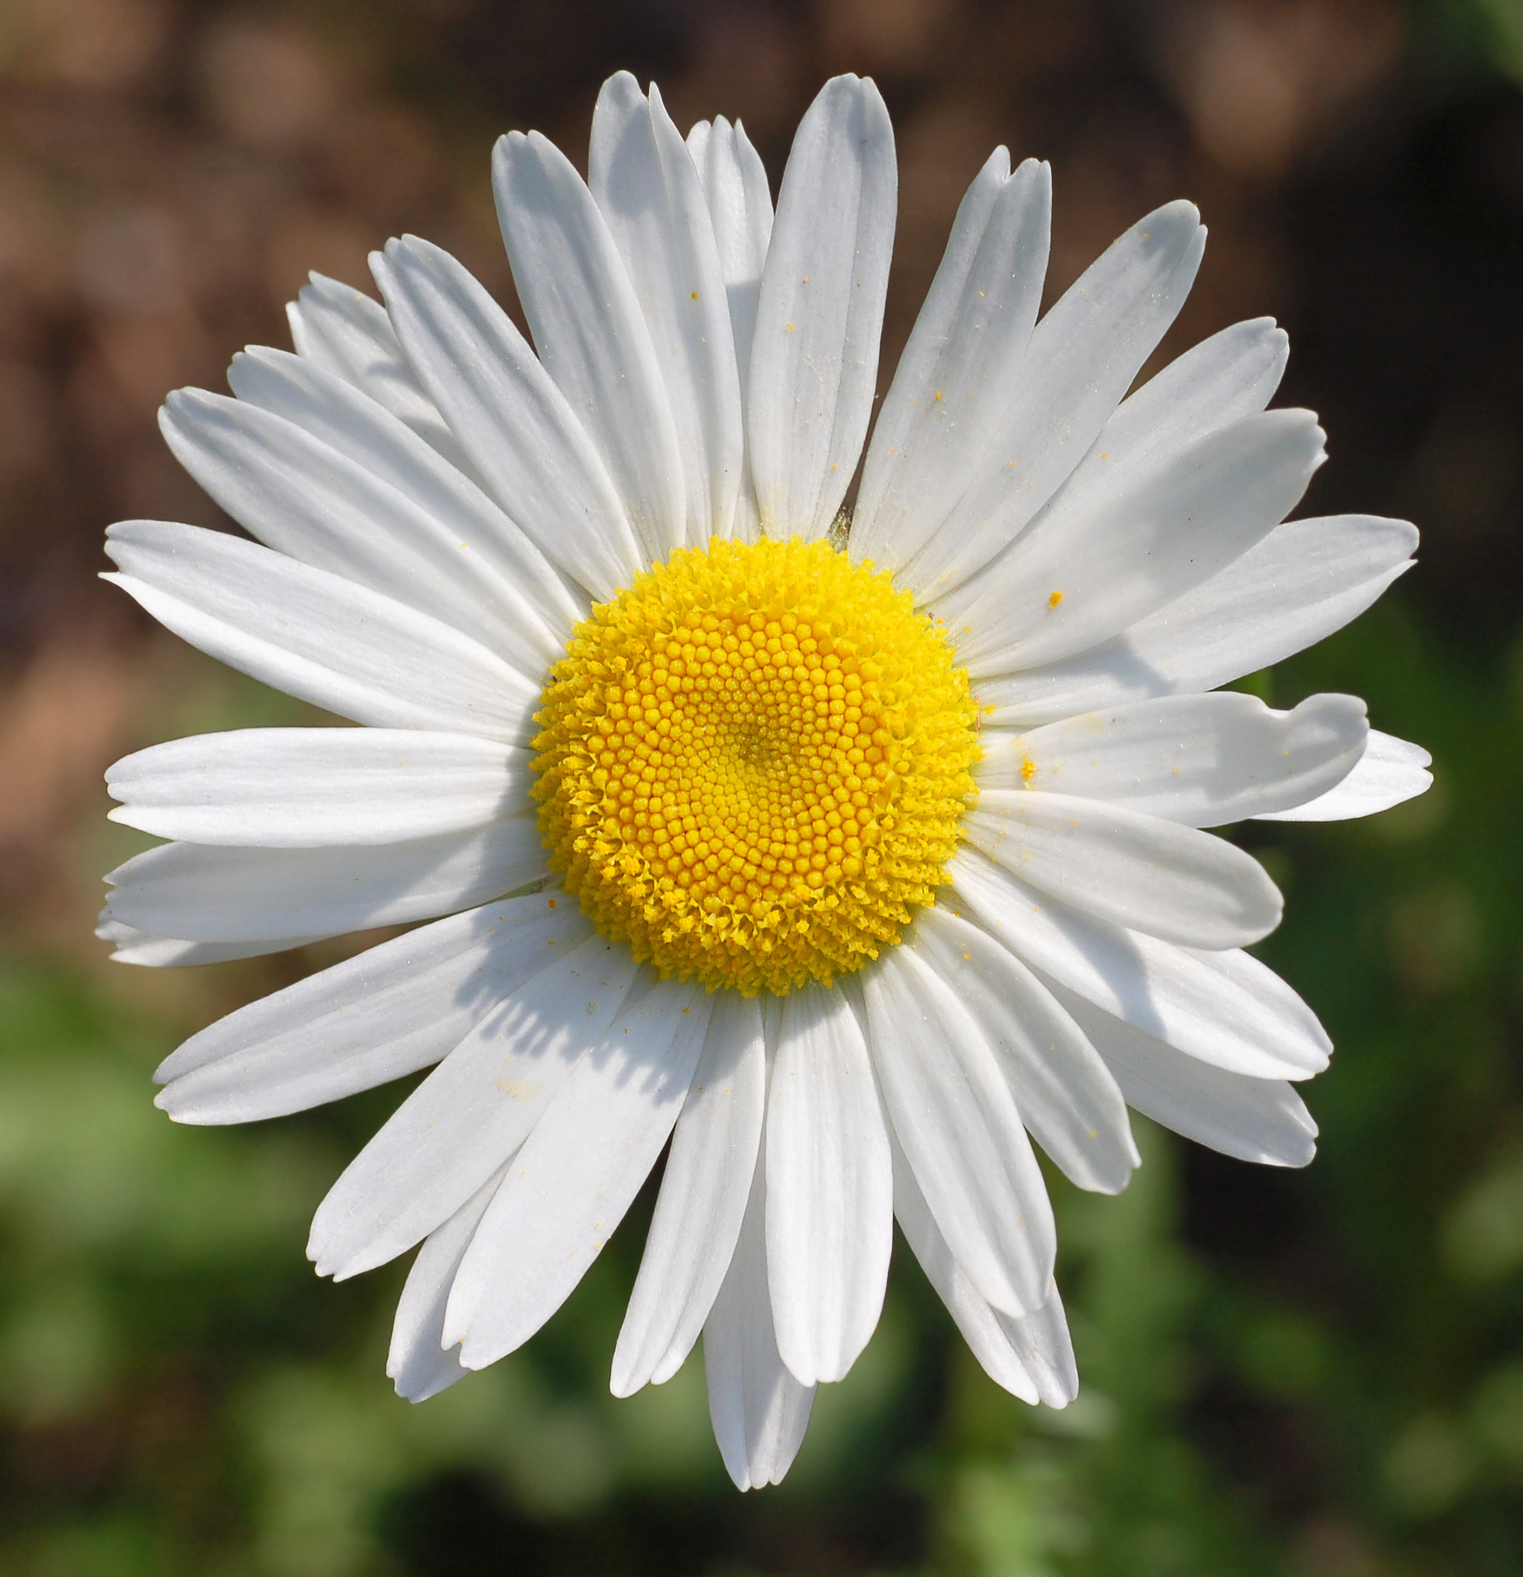

Slide 21
Although this is a far stretch it is still applicably valid because Daisy is corrupt.
She is essentially a gold digger—a digger for the appearance of wealth.
She didn’t want to marry Tom, but after presented with a $350 thousand necklace, she submits.
She is fake—like fake gold.
How does white contribute to her concern of appearance?
White is popular in decorating and in fashion because it is light, neutral, and goes with everything. However, white shows dirt and is therefore more difficult to keep clean than other colors.
How does white apply to Daisy in other ways?

Slide 22
Now, let’s apply yellow to Nick more accurately
“Dressed up in white flannels I went over to his lawn a little after seven and wandered around rather ill-at-ease among swirls and eddies of people I didn’t know” (46).
This is Nicks first time going over to Gatsby’s.

